Slide 1
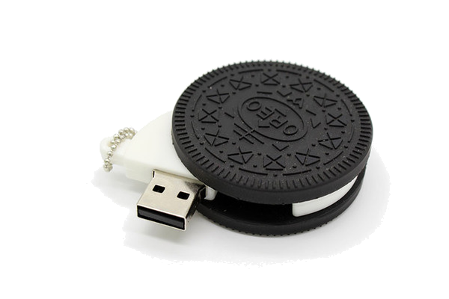
OREO OS
User Manual | Version 5.0
Course Information
7th February 2020
Dr. Camille Hayhurst
CS 450 - Operating Systems Structure
Team Members
Christine Fryling
Jacquelyn von Staden
Liye Yang
Raneem AlGhawi
4/13/20
<number>

Slide 2

User Manual | OREO OS
Table of Contents
Introduction 4
MAIN MENU 4
Available Commands 4
Help 5
Get Date 5
Set Date 6
Get Time 6
Set Time 7
Version 7
Shutdown 8
Change Color 8
Clear 9
Suspend 9
Resume 10
Set Priority 10
Show PCB 11
Show Alll Processes 11
Show Ready Processes 12
Show Blocked Processes 12
Create PCB 13
Delete PCB 13
Block PCB 14
Unblock PCB 14
Yield 15
LOADR3 15
Create infinite 16
Delete infinite 16
Show Free Memory 17
Show Allocated Memory 17
4/13/20
<number>

Slide 3
User Manual | OREO OS
Table of Figures
MAIN MENU 4
Help 5
Get Date 5
Set Date 6
Get Time 6
Set Time 7
Version 7
Shutdown 8
Change Color 8
Clear 9
Suspend 9
Resume 10
Set Priority 10
Show PCB 11
Show All Processes 11
Show Ready Processes 12
Show Blocked Processes 12
Create PCB 13
Delete PCB 13
Block PCB 14
Unblock PCB 14
Yield 15
Loadr3 15
Create infinite 16
Delete infinite 16
Show Free Memory 17
Show Allocated Memory 17
4/13/20
<number>

Slide 4
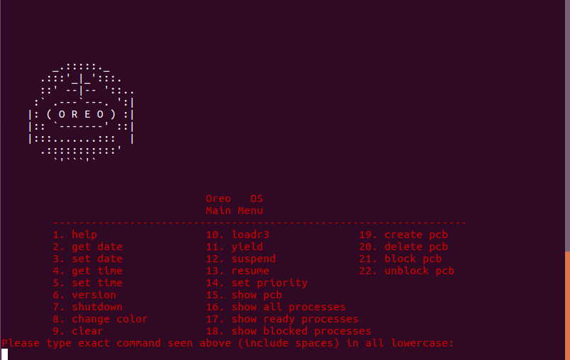
User Manual | OREO OS
Introduction
Oreo OS is a software project that is responsible for Memory Protection Extension (MPX) featuring. The team handled designing a user interface to let the user communicate with the system via using virtual serial port and to let the user accomplish some basic tasks such as getting time, date and time modification, get version, get help and lastly shut down the system. The team developed the system to be able to interact with the user easily and to be functional.
Main Menu
The OREO OS starts the system by showing the main menu, which has some commands that the user can choose from depending on what they would like to do. The user could type the name of the command in lower case.
4/13/20
<number>

Slide 5
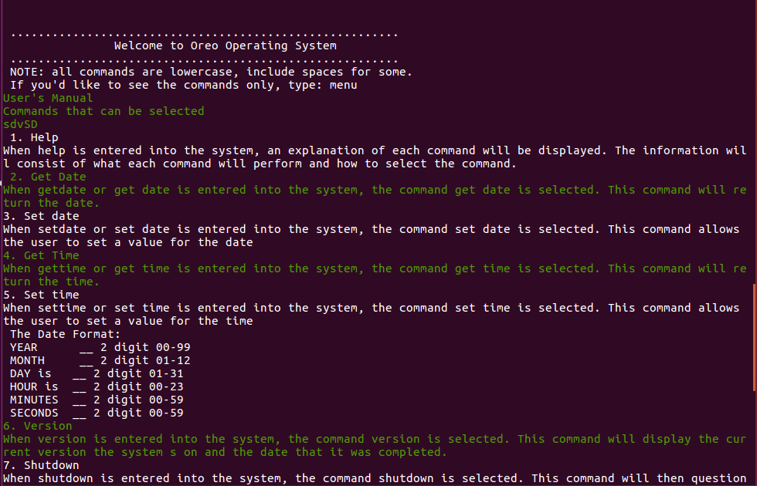
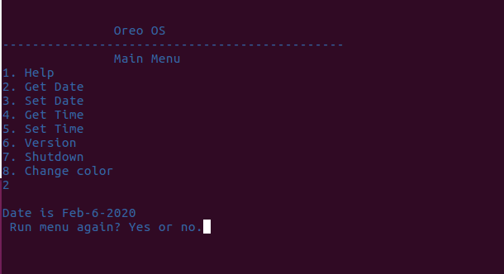
User Manual | OREO OS
Available Commands
Help
Help command can be launched by choosing number 1 from the main menu. It has an explanation of every command and its functionality. As it also provides the user the instructions of using Oreo OS and ask the user if they want to run the menu again.
Get Date
Get Date command can be launched by choosing number 2, its purpose is to show the current Date.
4/13/20
<number>

Slide 6
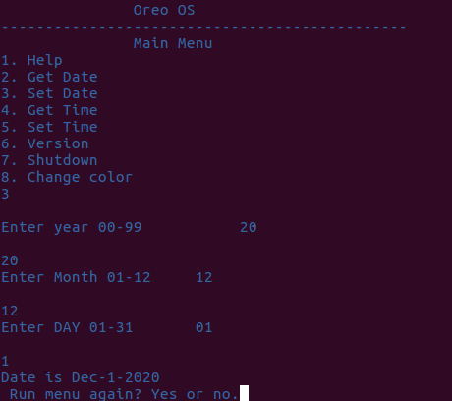
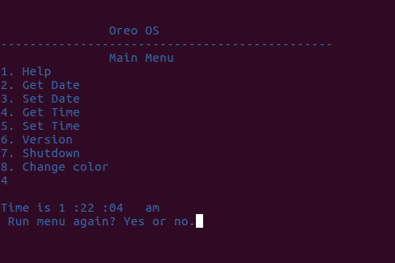
User Manual | OREO OS
User Manual | OREO OS
Set Date
Set Date command can be launched by choosing number 3 from the main menu, its purpose is to receive an input from the use
Set Date command can be launched by choosing number 3 from the main menu, its purpose is to receive an input from the user for year, month and day.
Set Date command can be launched by choosing number 3 from the main menu, its purpose is to receive an input from the user for year, month and day.
Get Time
Get Time command can be launched by choosing number 4 from the main menu, its purpose Is to show the current time.
4/13/20
<number>

Slide 7
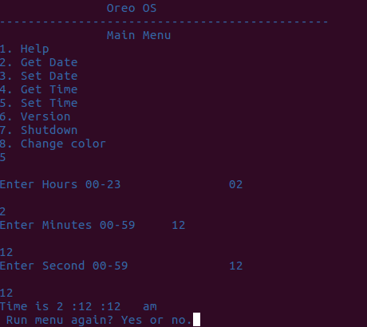
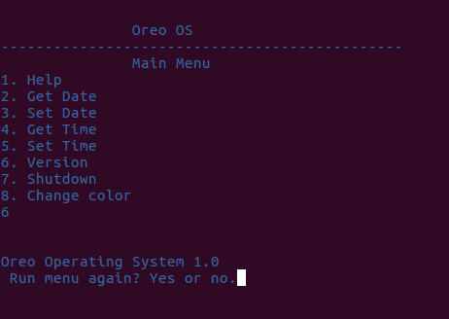
User Manual | OREO OS
Set Time
Set Time command can be launched by choosing number 5 from the main menu, its purpose is to receive an input from the user for hour, minutes and seconds.
Version
Get Version command can be launched by choosing number 6 from the main menu, its purpose is to show the release version of OREO OS
4/13/20
<number>

Slide 8
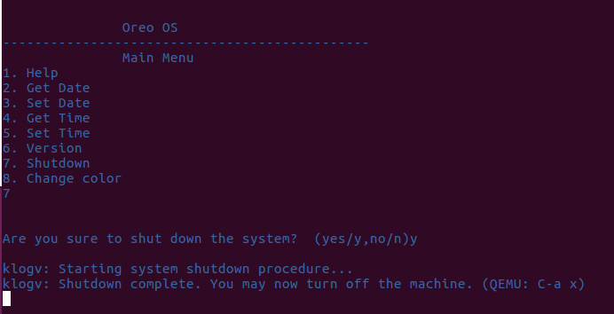
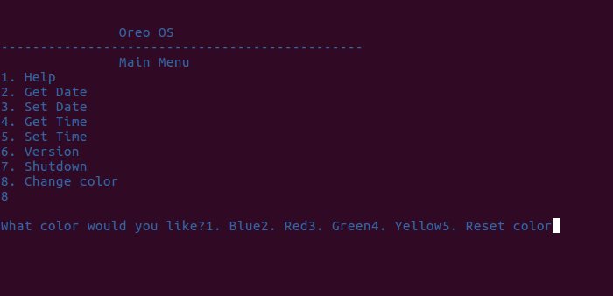
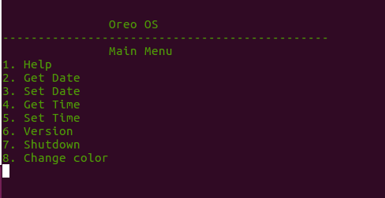
User Manual | OREO OS
User Manual | OREO OS
ShutDown
ShutDown command can be launched by choosing number 7 from the main menu, its purpose is to exit from OREO OS once receiving a confirmation from the user.
Change Color
Change Color command can be launched by choosing number 78from the main menu, its purpose is to show the user some color options provided and choose in which color they want the OREO OS to perform in.
4/13/20
<number>

Slide 9
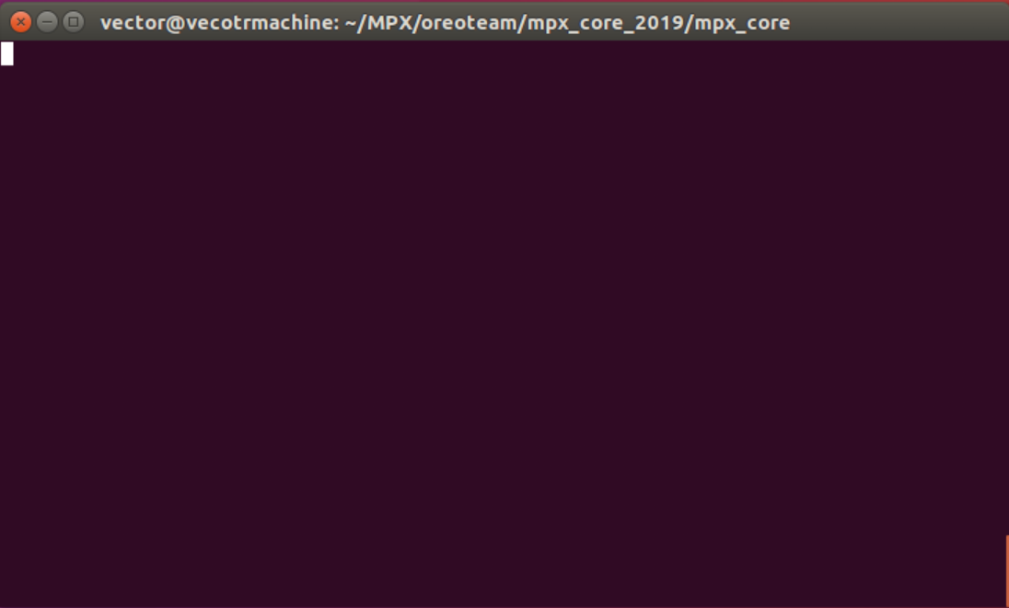
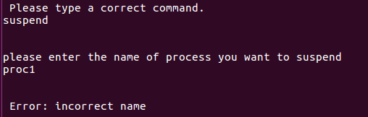
User Manual | OREO OS
Clear
Clear command can be launched by typing clear all in lowercase from the main menu, its purpose is to clear all the history of commands executed.
PCB Menu
Suspend
Suspend command can be launched by typing suspend in lowercase , its purpose is to allow the user to suspend a PCB
4/13/20
<number>

Slide 10
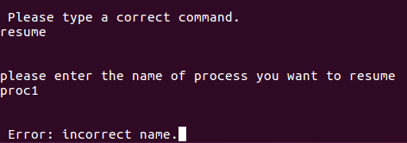
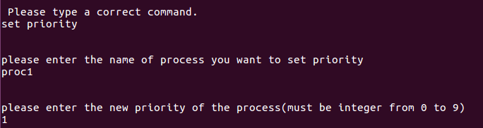
User Manual | OREO OS
Resume
Resume command can be launched by typing resume in lowercase, its purpose is to allow the user to resume a PCB
Set Priority
Set Priority command can be launched by typing set priority in lowercase, its purpose is to allow the user to set the priority of a pcb
4/13/20
<number>

Slide 11
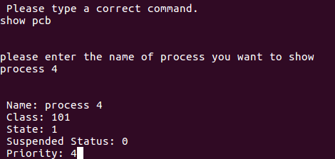
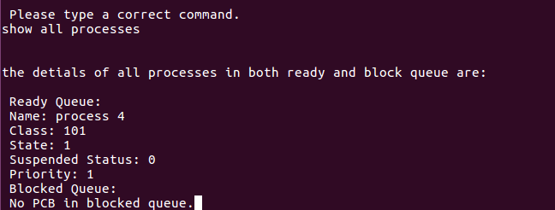
User Manual | OREO OS
Show PCB
Show PCB command can be launched by typing show pcb all in lowercase, its purpose is to show a PCB
Show All Processes
Show all Processes command can be launched by typing show all processes all in lowercase, its purpose is to show all processes whether they are blocked or ready.
4/13/20
<number>

Slide 12
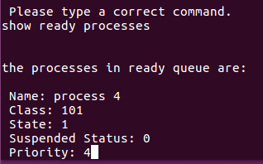
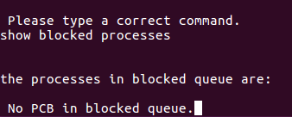
User Manual | OREO OS
Show Ready Processes
Show Ready Processes command can be launched by typing show ready processes all in lowercase, its purpose is to show all ready processes
Show Blocked Processes
Show Blocked Processes command can be launched by typing show blocked processes all in lowercase, its purpose is to show all blocked processes
4/13/20
<number>

Slide 13
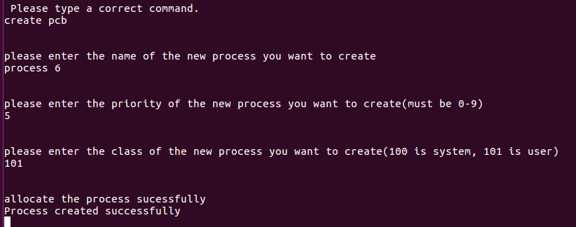
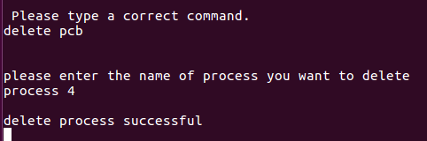
User Manual | OREO OS
Create PCB
Create PCB command can be launched by typing create pcb all in lowercase, its purpose is to allow the user to create a new PCB
Delete PCB
Delete PCB command can be launched by typing delete pcb all in lowercase , its purpose is to allow the user to delete an existing PCB
4/13/20
<number>

Slide 14
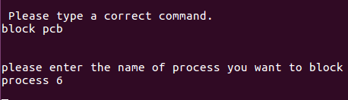
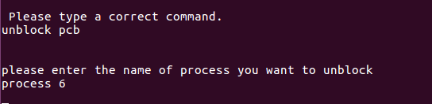
User Manual | OREO OS
Block PCB
Block PCB command can be launched by typing block pcb all in lowercase , its purpose is to block a PCB
Unblock PCB
unblock PCB command can be launched by typing unblock pcb all in lowercase , its purpose is to allow the user to unblock a blocked PCB.
4/13/20
<number>

Slide 15
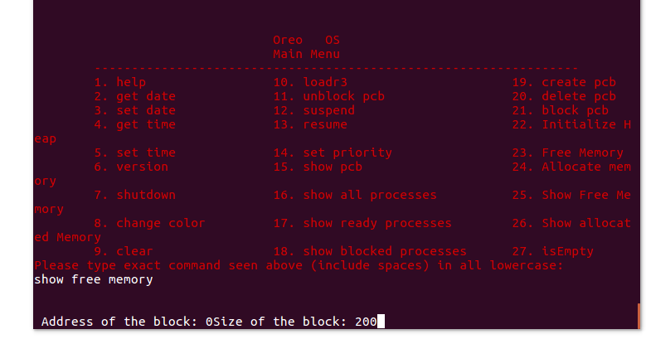

User Manual | OREO OS
Show Free Memory
Show Free Memory command can be launched by, it will traverse the list to show the address of the block and the size of it.
Show Allocated Memory
Show Allocated Memory command can be launched by, it will traverse the list to show the address of the block and the size of it.
4/13/20
<number>

Slide 16
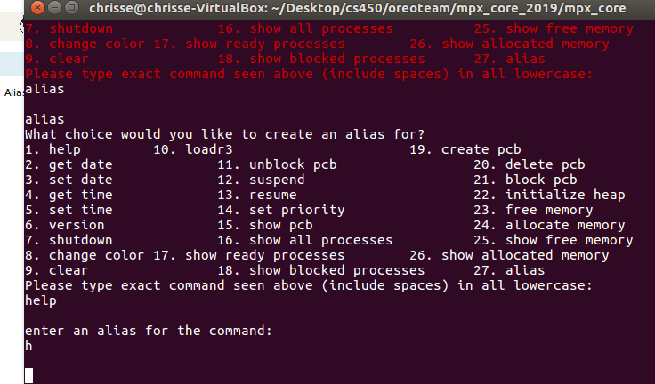
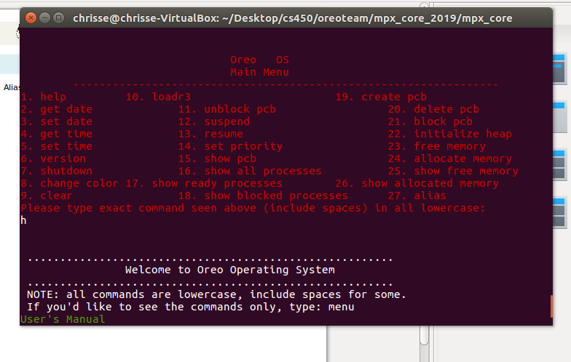
User Manual | OREO OS
Alias
Alias allows you to alias your commands to be shorter.
4/13/20
<number>

Slide 17
User Manual | OREO OS
Temp Commands for Testing
Currently, we have a few temporary commands in for testing.
1. initialize heap
This initializes the heap to 200.
2. allocate memory
This allocates memory.
3. free memory
This frees memory.
4. show free memory
Shows all free memory.
5. show allocated memory
Shows all allocated memory
4/13/20
<number>

